Slide 1
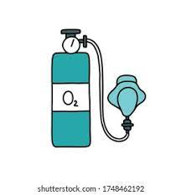
Fundamentals of Nursing(1st Stage)
Oxygen Therapy (Practice)
Lecture 5
University of Basrah –College of Nursing – Fundamentals of Nursing Department

Slide 2
Introduction
Oxygen: a gas found in the air we breathe, is necessary for human life, which constitutes 21% of normal air , is a tasteless, odorless, and colorless gas.
Some people with breathing disorders can’t get enough oxygen naturally. They may need supplemental oxygen, or oxygen therapy. People who receive oxygen therapy often see improved energy levels, improved sleep, and an overall better quality of life.

Slide 3
Who Needs Oxygen Therapy?
Oxygen therapy is prescribed for people who can’t get enough oxygen on their own. This is often because of a lung condition that prevents the lungs from absorbing oxygen, including:
COPD
Pneumonia
Asthma
Dysplasia or underdeveloped lungs in newborns

Slide 4
Heart failure
Cystic fibrosis
Sleep apnea
Lung disease
Trauma to the respiratory system

Slide 5
Precautions for oxygen administration
Avoid open flames in the patient’s room.
Place “no smoking” signs in conspicuous places in the patient’s room or home .
Check to see that electrical equipment used in the room such as radios ,razors, and in suctioning equipment .
Avoid wearing and using synthetic fabrics that build up static electricity .
Avoid using oils in the area .oil can ignite spontaneously in the presence of oxygen .

Slide 6
Oxygen Flow Rate
The flow rate of O2 , measured in liters per minute , determines the amount of O2 delivered to the patient.
The rate varies depending on:
Condition of the patient.
Route of administration of the oxygen .

Slide 7
Oxygen delivery system
Selection of the type of oxygen delivery system is based on the:
Level of oxygen support that the patient needs.
Severity of the hypoxia and the disease process
Patient’s age, level of health and orientation.
Presence of an artificial airway.
Whether the setting is in the hospital or the home.
Type of home environment.
Type of support and care given after discharge.

Slide 8
Oxygen delivery devices fall into one of two categories, high flow or low flow, depending on their ability to provide enough flow to match the patient’s spontaneous minute volume.
High-flow devices include venturi-mask, large-volume nebulizer, and blender masks.
Low-flow devices include nasal cannula and simple mask, non rebreather, mask and partial rebreather masks.

Slide 9
1- Nasal cannula
A nasal cannula is a simple, effective, and comfortable device for delivering oxygen to a patient. Oxygen is delivered via the cannula at a flow rate from 1 to 6 L/ min. Higher flow rates dry airway mucosa and do not increase the inspired oxygen concentration.

Slide 10
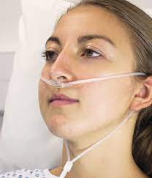

Slide 11
Advantages
Safe and simple
Easily tolerated
Allowing patient to eat, speak, and drink
Inexpensive and disposable

Slide 12
Disadvantages
Drying to mucous membranes Can dislodge easily
May cause skin irritation or breakdown
Patient’s breathing pattern will affect exact FiO2

Slide 13
2- Oxygen Mask
Advantages
Can help to provide humidified O2.
Disadvantages
increased levels of humidification may irritate skin
Interferes with eating and talking

Slide 14
The simple face mask
It is used for short-term oxygen therapy. It fits loosely and delivers oxygen concentrations from 40% to 60%. The mask is contraindicated for patients with carbon dioxide retention because it makes the retention worse. The percentage of oxygen delivered with a simple face mask depends on the liter flow and depth of respirations.

Slide 15
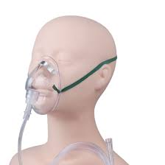

Slide 16
A plastic face mask with a reservoir bag
The plastic face mask with a reservoir bag delivers 60% to 90% oxygen at appropriate flow rates. This oxygen mask maintains a high-concentration oxygen supply in the reservoir bag. Frequently inspect the bag to make sure that it is fully inflated. If it is not fully inflated, the patient breathes in large amounts of exhaled carbon dioxide.

Slide 17
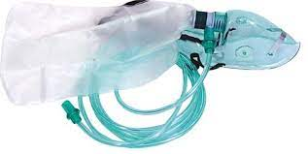

Slide 18
Venturi mask
is a cone-shaped high-flow device with entrainment ports of various sizes at the base of the mask. The entrainment ports adjust to permit regulation of FiO2 from 24% to 60%. This mask is useful because it delivers a more precise concentration of oxygen to a patient.

Slide 19
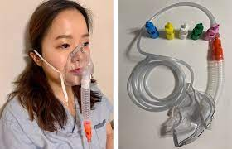

Slide 20
The face tent
is a shield like device that fits under a patient’s chin and sweeps around the face .It is used primarily for humidification and for oxygen only when a patient cannot or will not tolerate a tight-fitting mask. Because it is so close to a patient’s face, there is no way to estimate how much oxygen is delivered to him or her.

Slide 21
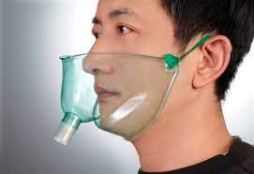

Slide 22
Partial non rebreather mask
Bag should always remain partially inflated. Therefore flow rate must be high enough to prevent collapse of bag.
Deliver 80% - 90% .

Slide 23
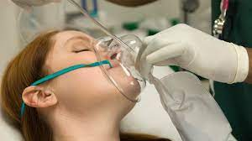

Slide 24
Equipment
Oxygen delivery device as ordered by health care provider
Oxygen tubing (consider extension tubing)
Humidifier, if indicated
Sterile water for humidifier
Oxygen source
Oxygen flow meter
Appropriate room signs

Slide 25
Nursing Diagnosis
Ineffective airway clearance
Impaired gas exchange
Ineffective breathing pattern
Related factors are individualized based on patient’s condition or needs.

Slide 26
Procedure
1- Perform hand hygiene. Apply face shield if risk of exposure to splashing mucus exists.
2- Identify patient using two identifiers (i.e., name and birthday or name and account number) according to agency policy.
3- Attach oxygen delivery device (e.g., cannula, mask) to oxygen tubing and attach end of tubing to humidified oxygen source adjusted to prescribed flow rate.
4- Apply oxygen device:
A - Place the two tips of the cannula into patient’s nares. If the tips are curved, they should point downward inside the nostrils. Then loop the cannula tubing up and over patient’s ears. Adjust the lanyard so the cannula fits snugly but not too tightly.
B- Apply a mask by placing it over patient’s mouth and nose. Then bring the straps over patient’s head and adjust to form a comfortable but tight seal.

Slide 27
5- Maintain sufficient slack on oxygen tubing and secure to patient’s clothes.
6- Verify setting on flow meter and oxygen source for proper setup and prescribed flow rate.
7- Check cannula/mask every 8 hours. Keep humidification container filled at all times.
8- Perform hand hygiene.

Slide 28
THANKS

